Slide 1
WHERE to GO in ISTANBUL, TURKEY
By
RAFET YILDIRIM
29.11.2021

Slide 2
Introduction
İstanbul is a large city and trade capital of Turkey, which is composed of a number of sectors and has a total area of 5.461 square km. There are many venues (especially restaurants, hotels and cafes) which can be explored.
İstanbul is placed at the connection of Europa and Asia. City and continents are divided by the Bosphorus, that is connect the Black Sea to Marmara Sea. It was the capital city of famous empires, such as East Rome and Ottoman. So it has many historical places, and very attractive for tourists.
Whenever a tourist is visiting a city they start looking for places to visit during their stay. They primarily look for places based on the venue ratings across all venues and the average prices such that the locations fits in their budget.
Our aim by the project is to cluster venues in İstanbul, Turkey based on their rating and average prices.
We will present various venues in the city of İstanbul, Turkey, using Foursquare API and Zomato API, to help tourists select the restaurants that suit them the best.
Here, we will identify places that are fit for various individuals based on the information we collected from two APIs by using Data Science.
Once we have the plot with the venues, any company can launch an application using the same data and suggest users such information.

Slide 3
Data Collection and APIs
To begin with, we will take a look at İstanbul on Map using the folium library. You will have an idea about the geography of the city.
Then we will get data from two different APIs.
Foursquare API: We will use the Foursquare API to get venues in İstanbul, in a circle of 6 km radius.
Zomato API: The Zomato API provides information about various venues including the complete address, user ratings, price for two people, price range and many more.

Slide 4
Using Foursquare API
We begin by fetching all venues in İstanbul up to a range of 6 Km using the Foursquare API. The Foursquare API has the explore API which allows us to find venues within a given radius from a given coordinates. We will use this API to find all the venues we need.
We will call the API over and over till we get all venues from the API within the given distance. The maximum venues this API can fetch is 100, so we will fetch all venues by iteratively calling.
Foursquare API requires client_id, and client_secret to function, which can be get after creating a developer account.
We will set the radius as 6 Kilometers.
The version is a required parameter which defines the date on which we are browsing.

Slide 5
Using Zomato API
The Zomato API allows to search for any given venue based on certain search filters such as query, latitude, longitude and more, by its Search Function. The function returns data only for open venues at the moment.
Zomato also requires a Zomato user key which can be got by having a developer account.
We will use "name, latitude and longitude" values of venues obtained using Foursquare API to use the Search Function and get more data for each venue.
The "query" will be the name of the venue.
The "start" defines from what offset we want to start, so it will be 0.
The "count" defines the number of venues we want to get. Because of having the exact location coordinates, we will fetch only one.
We will use the latitude and longitude values.
We will set the sorting criteria as real distance so each time we will get the venue based on their coordinates.

Slide 6
Merging and Cleaning Data
Data from multiple resources are not always aligned. So, it is important to merge the data retrieved from multiple resources properly.
To do this:
Firstly, we will plot the two data on map.
Then, we will try to merge data using their latitude and longitude values.
The key point is that: The coordinates are very close or the same for the same venue.
Finally: For the remaining venues, we will inspect the data for ensuring that any remaining mismatched or noisy data are also removed.
After performing the data cleaning actions, the final dataset will be ready for clustering analysis.

Slide 7
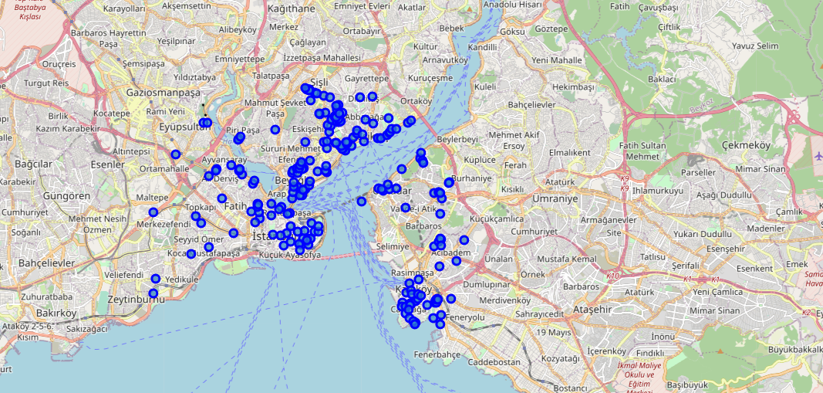
Venues by Foursquare

Slide 8
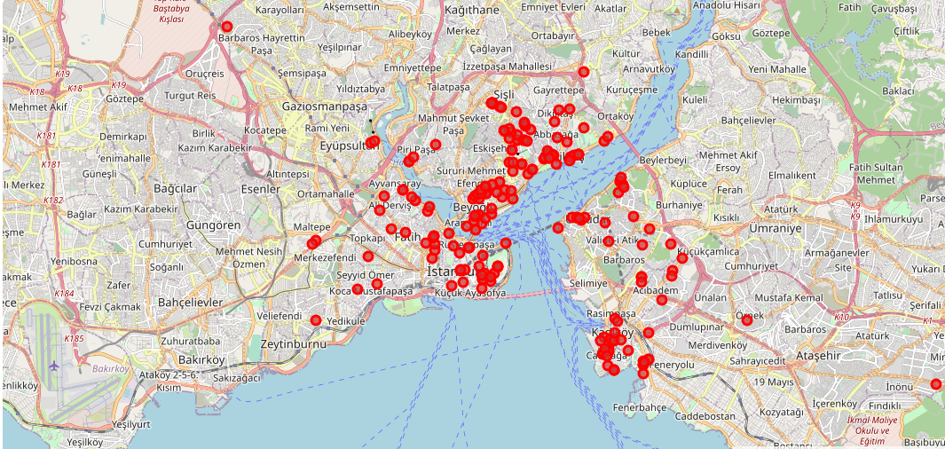
Venues by Zomato

Slide 9
Merging & Cleaning
When we inspect the data gathered from both APIs, names of some venues are completely different. This may be resulted from 3 things:
There are venues that have specific restaurants/cafes inside them as provided by Zomato API.
Some have been replaced with new restaurants.
Two locations are so close by that they have practically same latitude and longitude values.
The venues belong to 1&2 are OK for our analysis, but the venues of 3rd group should be removed. We do this by removing the name of the venues got from FourSquare API.
We have rating data obtained from FourSquare API. This is very valuable data for a person who do not have any info or insight abot the venue. So, we examine the Rating Data and see two cleaning need:
There are some venues with no-rating. So, we should remove these venues.
Some venues has a rating, but number of people who rated is low. So, it is hard to be sure the rating value really represents the venue or not (Maybe the mans of the venue rated :)). So, we should remove the venues with vote number below a certain number.

Slide 10
Methodology
Our goal is identifying and classifying the venues in İstanbul based on their rating and average prices. This would enable visitors to find venues easily based on their rating and price preferences.
Up to now, we:
Obtained venue data using two different APIs (Foursquare and Zomato).
Explored them on a map.
Examined them for merging and cleaning.
Created the final dataset for analysis, containing rating and price values for each venue.
Our next step is to analyse our data. For this we will perform below tasks:
Exploring the categories of venues using charts.
Exploring the count of venues with ratings and prices using charts.
Exploring the venues with high/low ratings and high/low prices on a map.
Next:
As the heart of the study, we will apply the k-Mean Clustering for grouping the venues based on their price and rating values. This will enable us to identify which venue(s) can be recommended for which type of visitors.
Finally:
We will discuss the results and conclude the overall study.

Slide 11
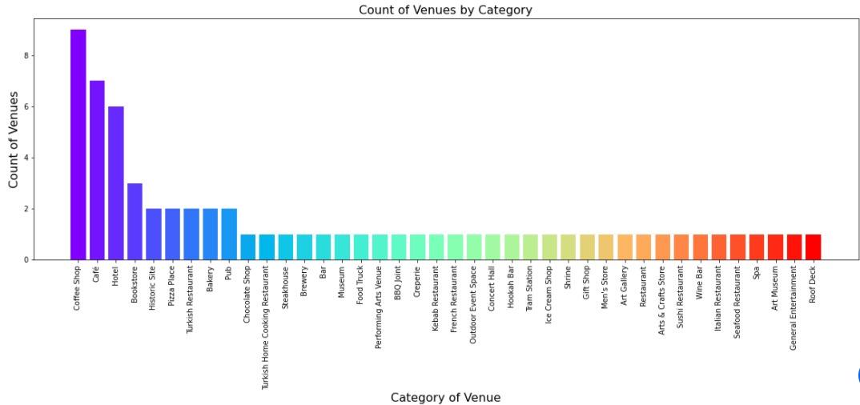
Categories
As seen on the chart, the majority venues are Coffee Shop, Cafe and Hotel. It seems that tourists are in this area of İstanbul for accomodation and resting.

Slide 12
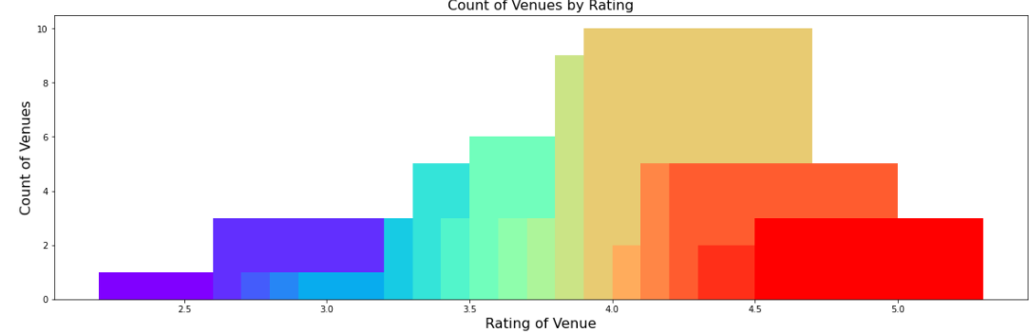
Rating
As seen on the plot above, majority venues have their rating between 4.0-4.5 interval.

Slide 13
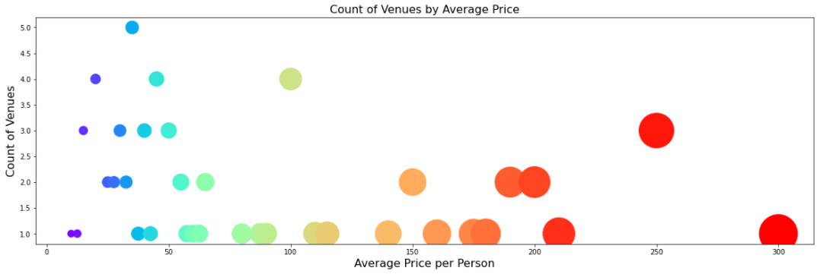
Price
From the plot above we can see that a large number of venues have an average price below 75 TL.

Slide 14
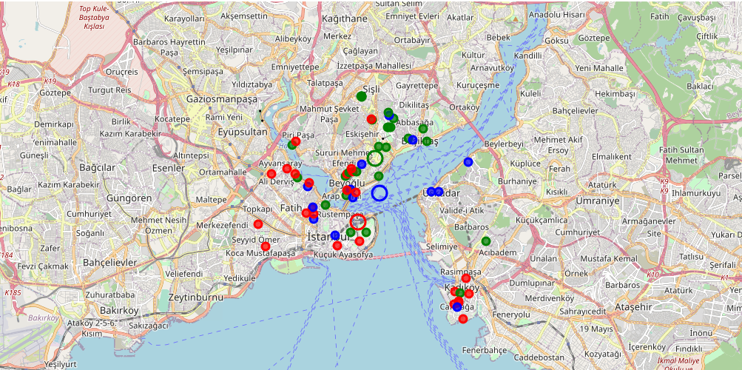
Clustering
As we mentioned before, it seems that there a significant correlation between Price Index and Location of venues.
We see the same figure on the map. Cluster-1&2 are located separately. Cluster-3 is everywhere :)

Slide 15
Results and Discussion
Based on our analysis above, we can make some conclusions that will be useful to help visitors of İstanbul, Turkey.
After collecting data from the Foursquare and Zomato APIs, we got a list of 216 different venues. However, not all venues from the two APIs were identical. Hence, we had to inspect their latitude and longitude values as well as names to combine them and remove all the noisy data. This resulted in a total venue count of 66.
We identified that from the total set of venues, majority of them were Cafes,Coffee Shop and Hotels. It seems that tourists are in this area of İstanbul for accomodation and resting.
While the complete range of ratings range from 1 to 5, the majority venues have ratings between 4.0-4.5. This means that most restaurants provide good quality food which is liked by the people of the city, thus indicating the high rating. When we plot these venues on the map, we see there is not a significant correlation between the location and rating of the venues.
When we take a look at the price values of each venue, we explore that many venues have prices which are below 75 TL for one person. On plotting the venues based on their price range on the map, we discovered that location of venues has a signicant correlation with the price range of venues.
Finally, through clusters we identified that the main independent parameter to identify the cluster is Price Range of the venue. We divided the venues into 3 groups, and named them:
Gourmet: Expensive, generally located around Beyoğlu&Şişli.
Worth_It: Good Price, generally located around Fatih.
Up_To_You: Low Price, all around.
This study can be used to build up an online website/mobile application, to provide visitors with up to date information about various venues in the city based on the search criteria (name, rating and price).

Slide 16
Conclusion
The purpose of this project was to explore the places that a tourist visiting İstanbul-Turkey could visit.
The venues have been identified using Foursquare and Zomato API and have been plotted on a map.
The map reveals that there are three major areas a person can visit: Fatih, Beyoğlu and Şişli.
Based on the visitor's venue rating and price requirements, they can decide where to visit.

